Slide 1



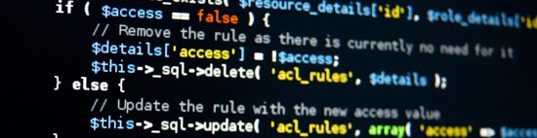
PHP MVC Frameworks
Course Introduction
SoftUni Team
Technical Trainers
Software University
http://softuni.bg

Slide 2

Table of Contents
Course Objectives
Course Program
Trainers Team
Examination
Learning Resources

Slide 3
Questions
sli.do #PHP-WEB

Slide 4


Questions
Software University - PHP Web Sept 2017
https://www.facebook.com/groups/352148105198948/

Slide 5

PHP MVC Frameworks
Course Objectives & Program

Slide 6
PHP MVC Frameworks – Course Program
Course Introduction – Course Program, Exams, Trainers, Evaluation…
MVC Intro – What is MVC? Custom MVC Framework
Symfony Basics – Installation, Controllers, Routes
ORM Basics – What is ORM? Doctrine, Queries, Repositories
Symfony Fundamentals – Forms, Security
Symfony Advanced – Crons, Events, Deploy

Slide 7
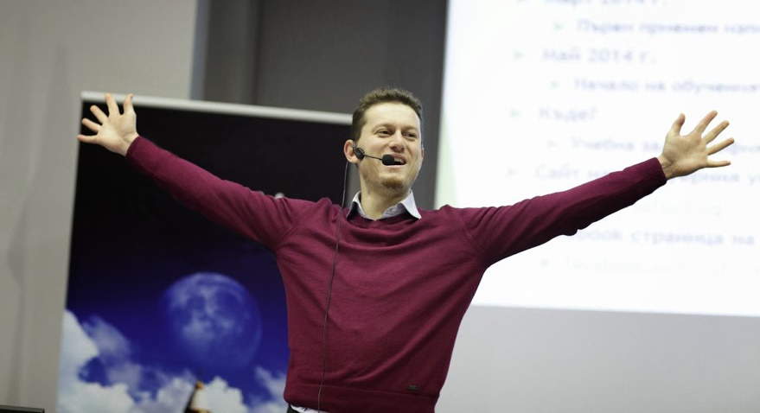
The Trainers Team

Slide 8
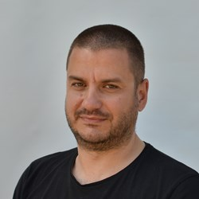
Trainers Team
Veselin Malezanov
Trainer @ Software University
20+ years of experience with PHP and WEB
Takes an active role in the development of www.abv.bg
Specialized in commercial software solutions

Slide 9
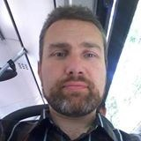
Trainers Team
Boyan Mihailov
Trainer @ Software University
Web Developer @ Design Force LTD.
12 years of experience with PHP and web development
Specialized in real-estate web applications

Slide 10
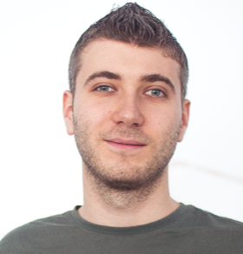
Trainers Team
Ivan Yonkov
Training Manager & Trainer @ SoftUni
5 years of programming experience mainly with Java and PHP
Solid experience as QA engineer
Top performing student from the Software University (2014)

Slide 11
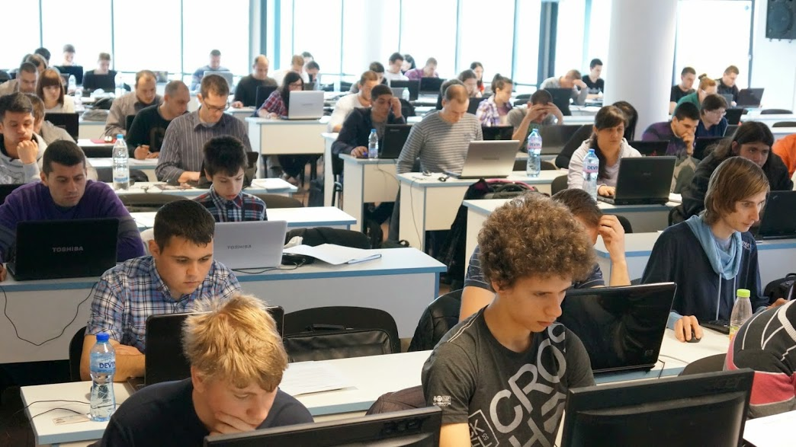
PHP Fundamentals: More Details
Duration, Languages, Technologies

Slide 12

Training Structure – PHP MVC Frameworks
Lectures
Practical exercises (in class)
Homework (after every lecture or at home)
Individual project
Exam preparation (Workshop)
Project Defenses
Schedule: November - December 2017
Final date: 22 December 2017

Slide 13



Why English?
Why the slides are in English?
English is the native language of the software engineers
Specific terminology should be in English
Translations are inaccurate and funny
Just learn English!
No excuses

Slide 14
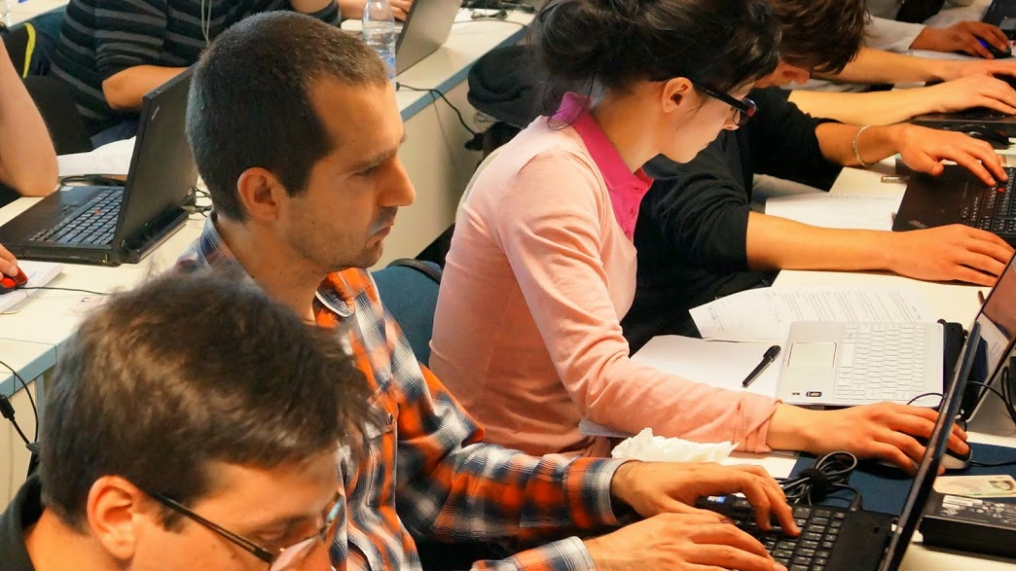
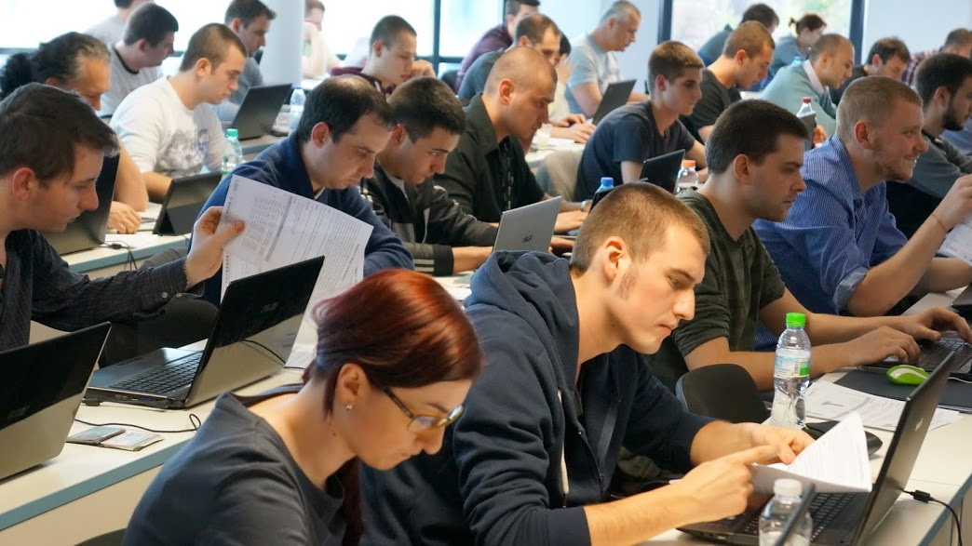

PHP MVC Frameworks
Evaluation Criteria

Slide 15


Scoring System for the "PHP MVC Frameworks"
Project – 90%
Homework – 10%
Bonuses: up to 10%
Presence in class (onsite students only) – 5%
Forum Activity – 5%

Slide 16
Practical Project
Develop a practical project
Choose from existing projects
Or work on your own idea
Public defense → demonstrate your work live at SoftUni

Slide 17





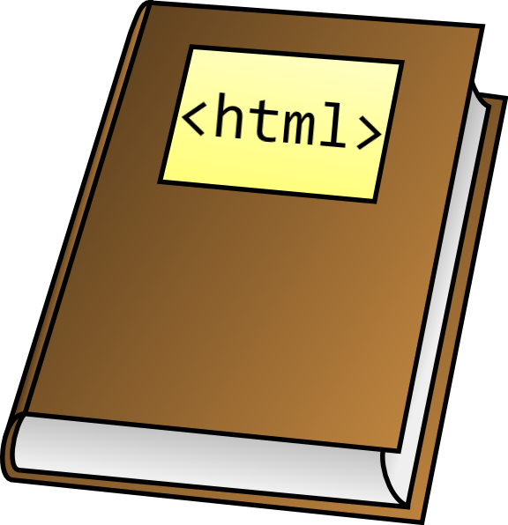



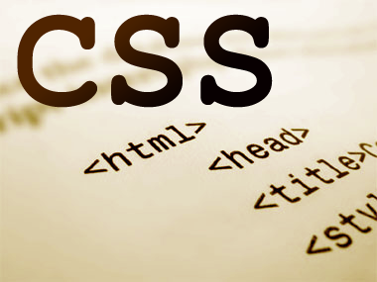
Resources
What We Need Additionally?

Slide 18

Course Web Site & Forums
The PHP MVC Frameworks official web site:
Register for the "Software University Forum":
Discuss the course exercises with your colleagues
Find solutions for all course exercises
Share source code / discuss ideas / help each other
https://softuni.bg/
https://softuni.bg/forum

Slide 19



PHP MVC Frameworks Slides and Videos
All lecture slides, videos, homework assignments, projects and other resources are open content, available for free
Visit the course web site to access the course resources

Slide 20
Symfony Resources
Symfony - The Book - https://symfony.com/pdf/Symfony_book_3.1.pdf
The Cookbook - http://symfony.com/doc/2.3/cookbook/index.html (might be older)

Slide 21









PHP MVC Frameworks – Course Intro
https://softuni.bg/courses/php-mvc-frameworks

Slide 22
License
This course (slides, examples, demos, videos, homework, etc.) is licensed under the "Creative Commons Attribution-NonCommercial-ShareAlike 4.0 International" license
Attribution: this work may contain portions from
“PHP/MySQL" course by SoftUni under CC-BY-NC-SA license

Slide 23





Free Trainings @ Software University
Software University Foundation – softuni.org
Software University – High-Quality Education, Profession and Job for Software Developers
softuni.bg
Software University @ Facebook
facebook.com/SoftwareUniversity
Software University @ YouTube
youtube.com/SoftwareUniversity
Software University Forums – forum.softuni.bg

